Slide 1

Price of house prediction in London

Slide 2

Objective: To build a machine learning model that predicts the selling price of houses in London based on features like location, size, number of rooms, and property type.

Slide 3
Why It Matters: Helps buyers and investors make informed decisions Assists real estate agents in pricing properties fairly Supports policymakers in understanding housing trends

Slide 4
Data Collection Sources: Open Government Data Portal Kaggle Dataset: "London Housing Data" Features include: Date, Price, Property Type, Location , Size , Bedrooms, Bathrooms, Year Built

Slide 5


Slide 6
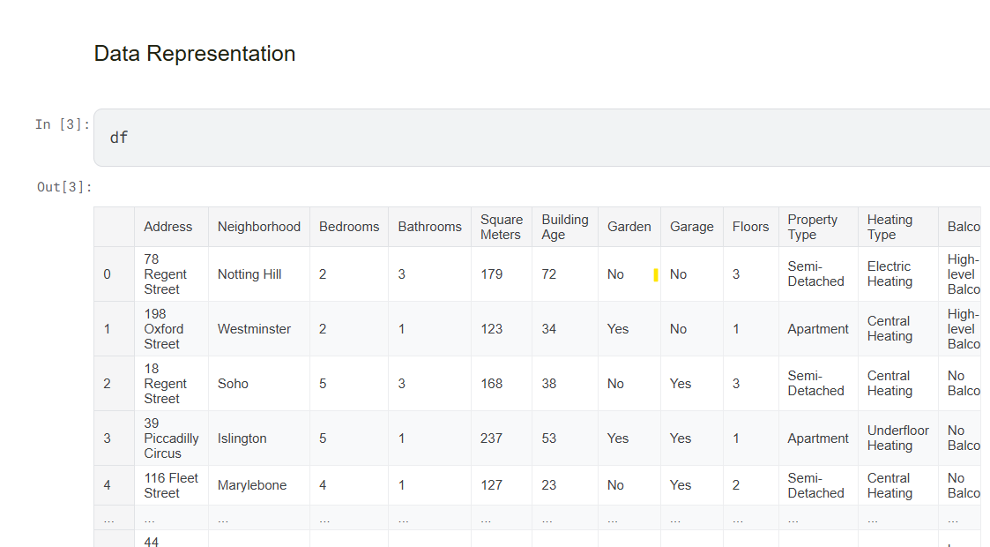

Slide 7
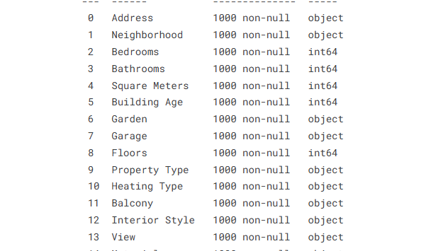

Slide 8
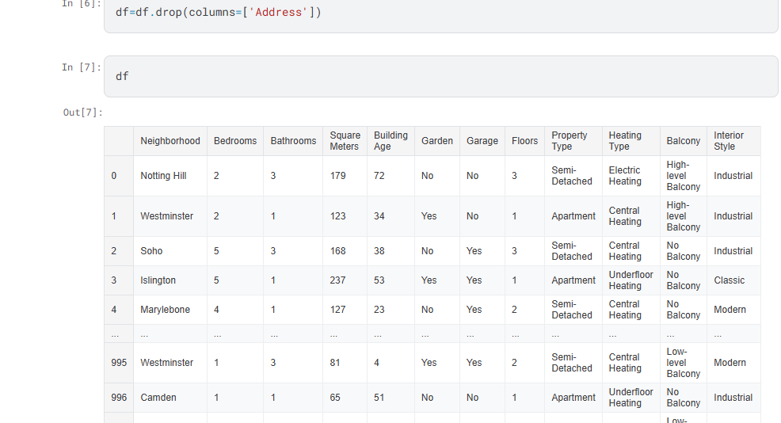

Slide 9
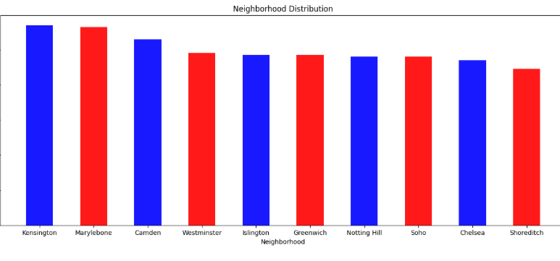

Slide 10
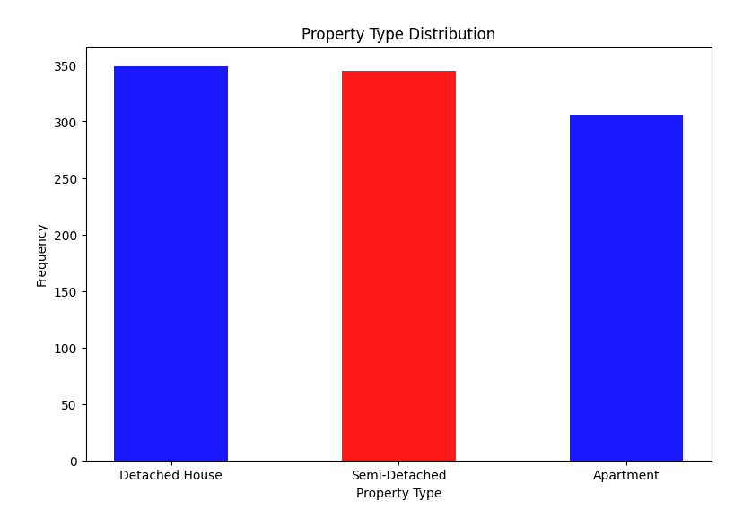

Slide 11
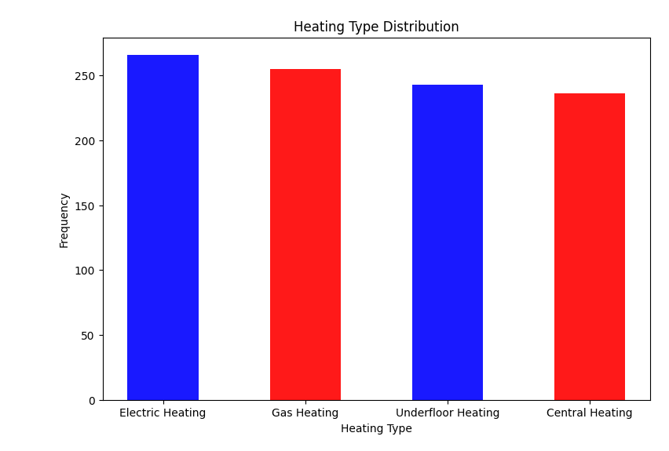

Slide 12
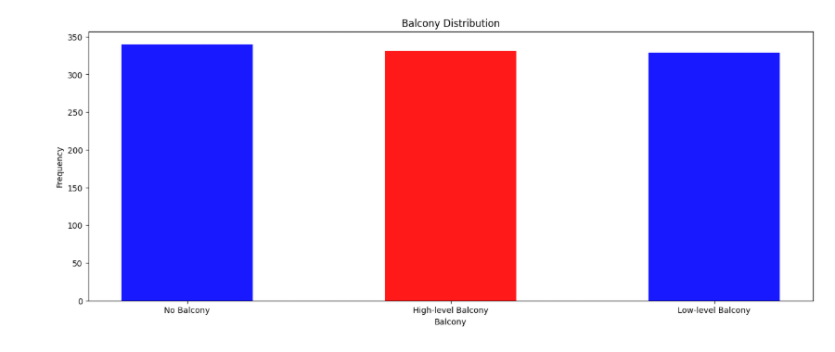

Slide 13
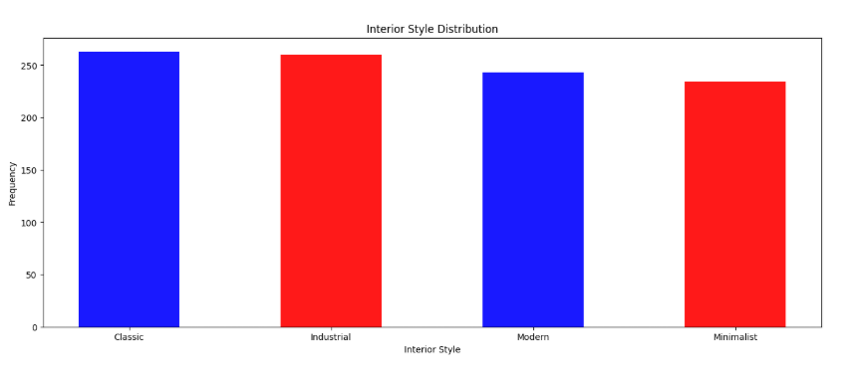

Slide 14
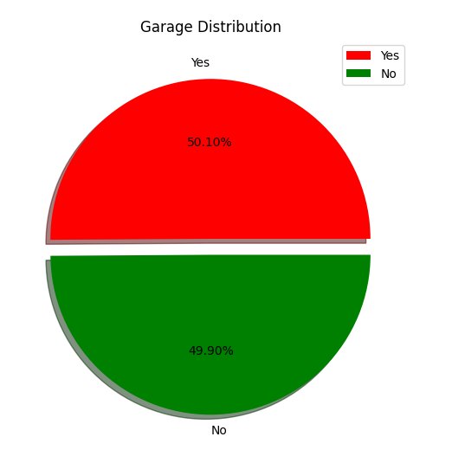
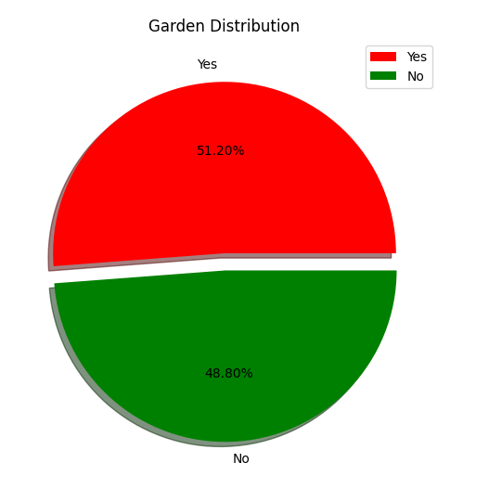

Slide 15
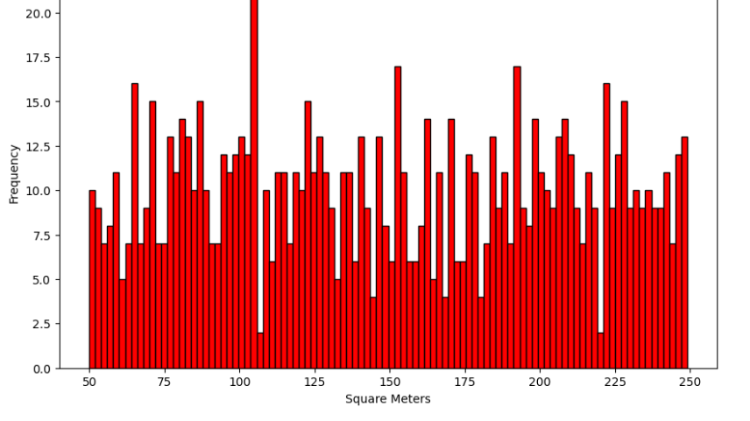

Slide 16
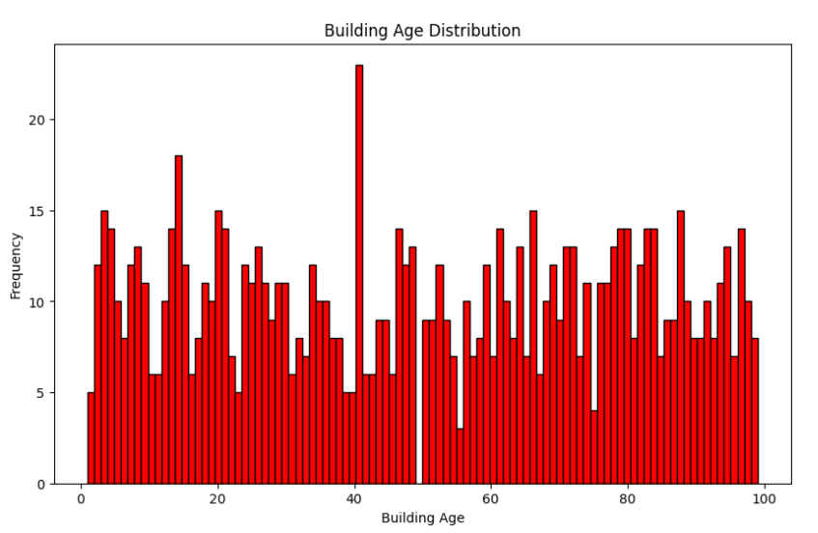

Slide 17
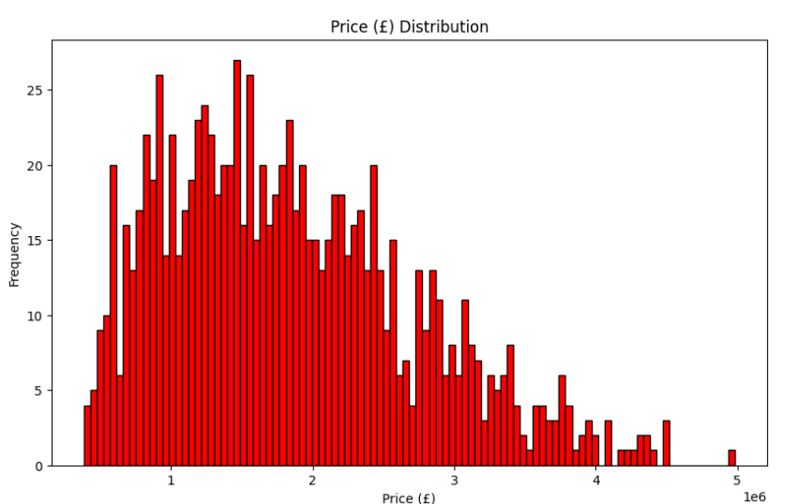

Slide 18
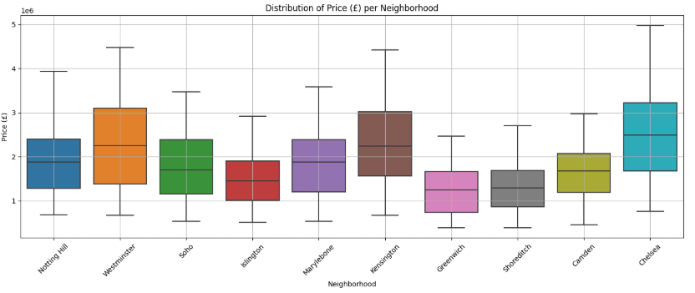

Slide 19
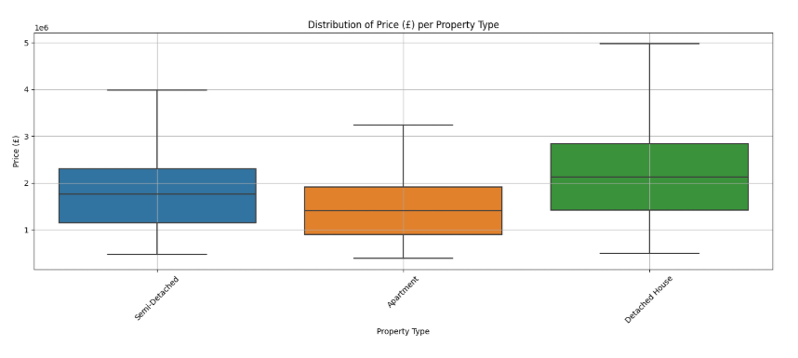

Slide 20
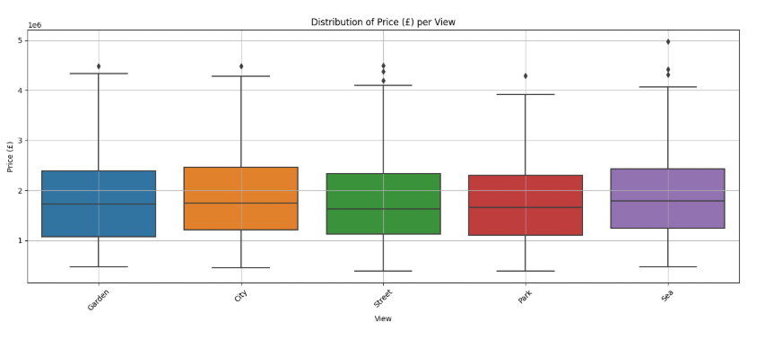

Slide 21
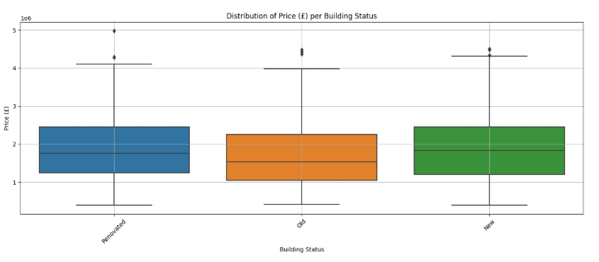

Slide 22
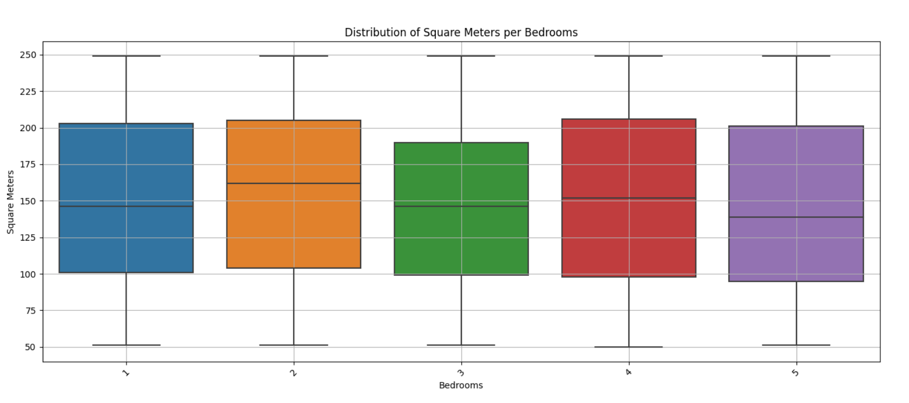

Slide 23
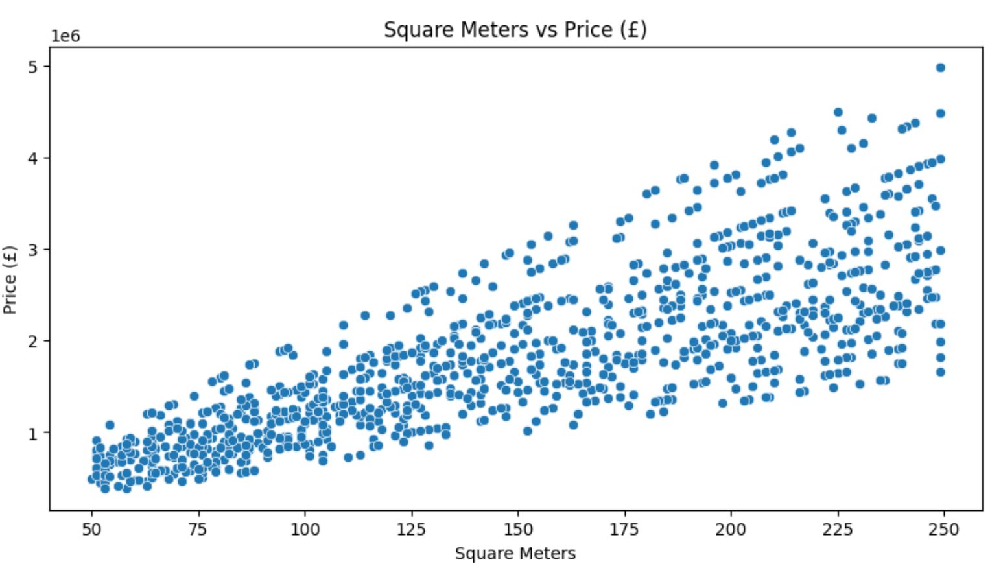

Slide 24
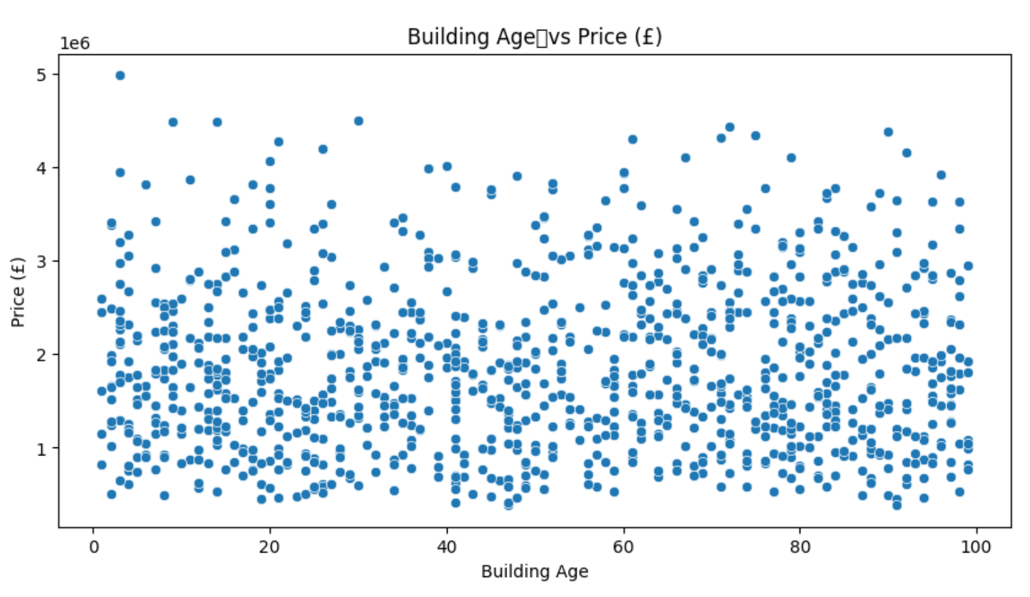

Slide 25
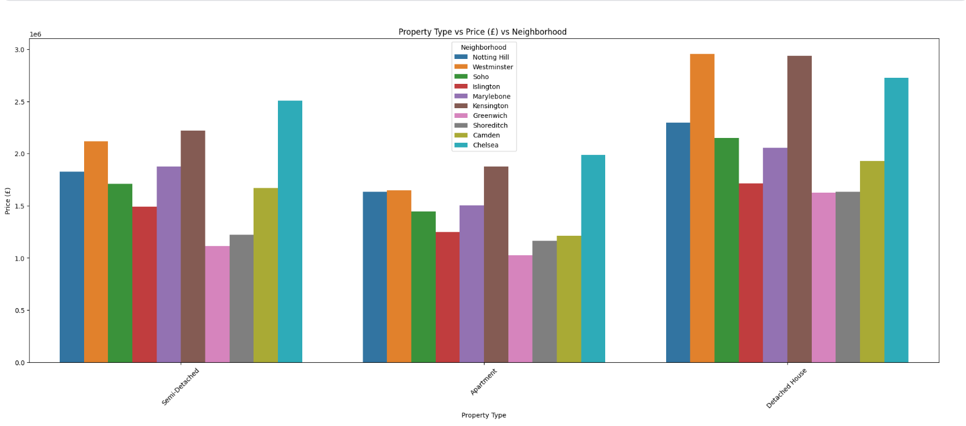

Slide 26


Slide 27
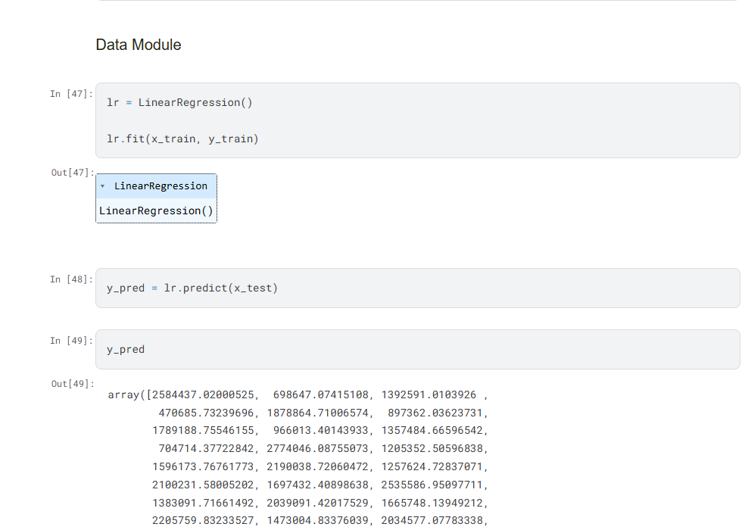

Slide 28
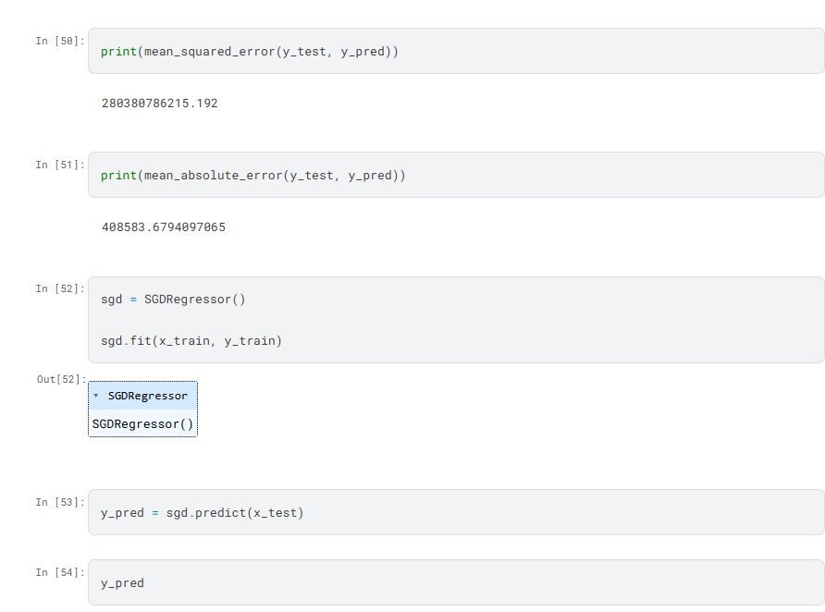

Slide 29
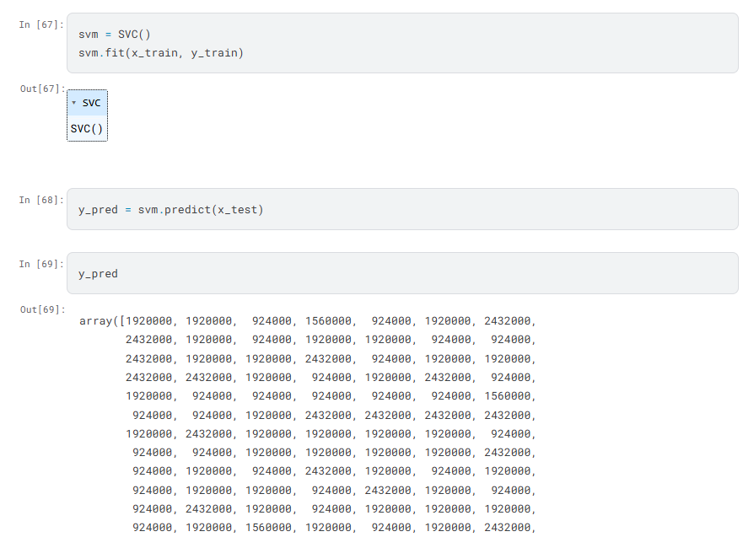

Slide 30
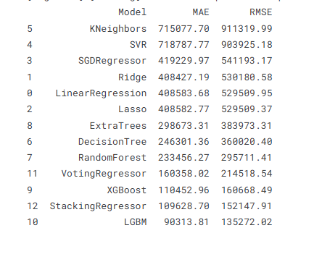

Slide 31
Thank you

